Slide 1
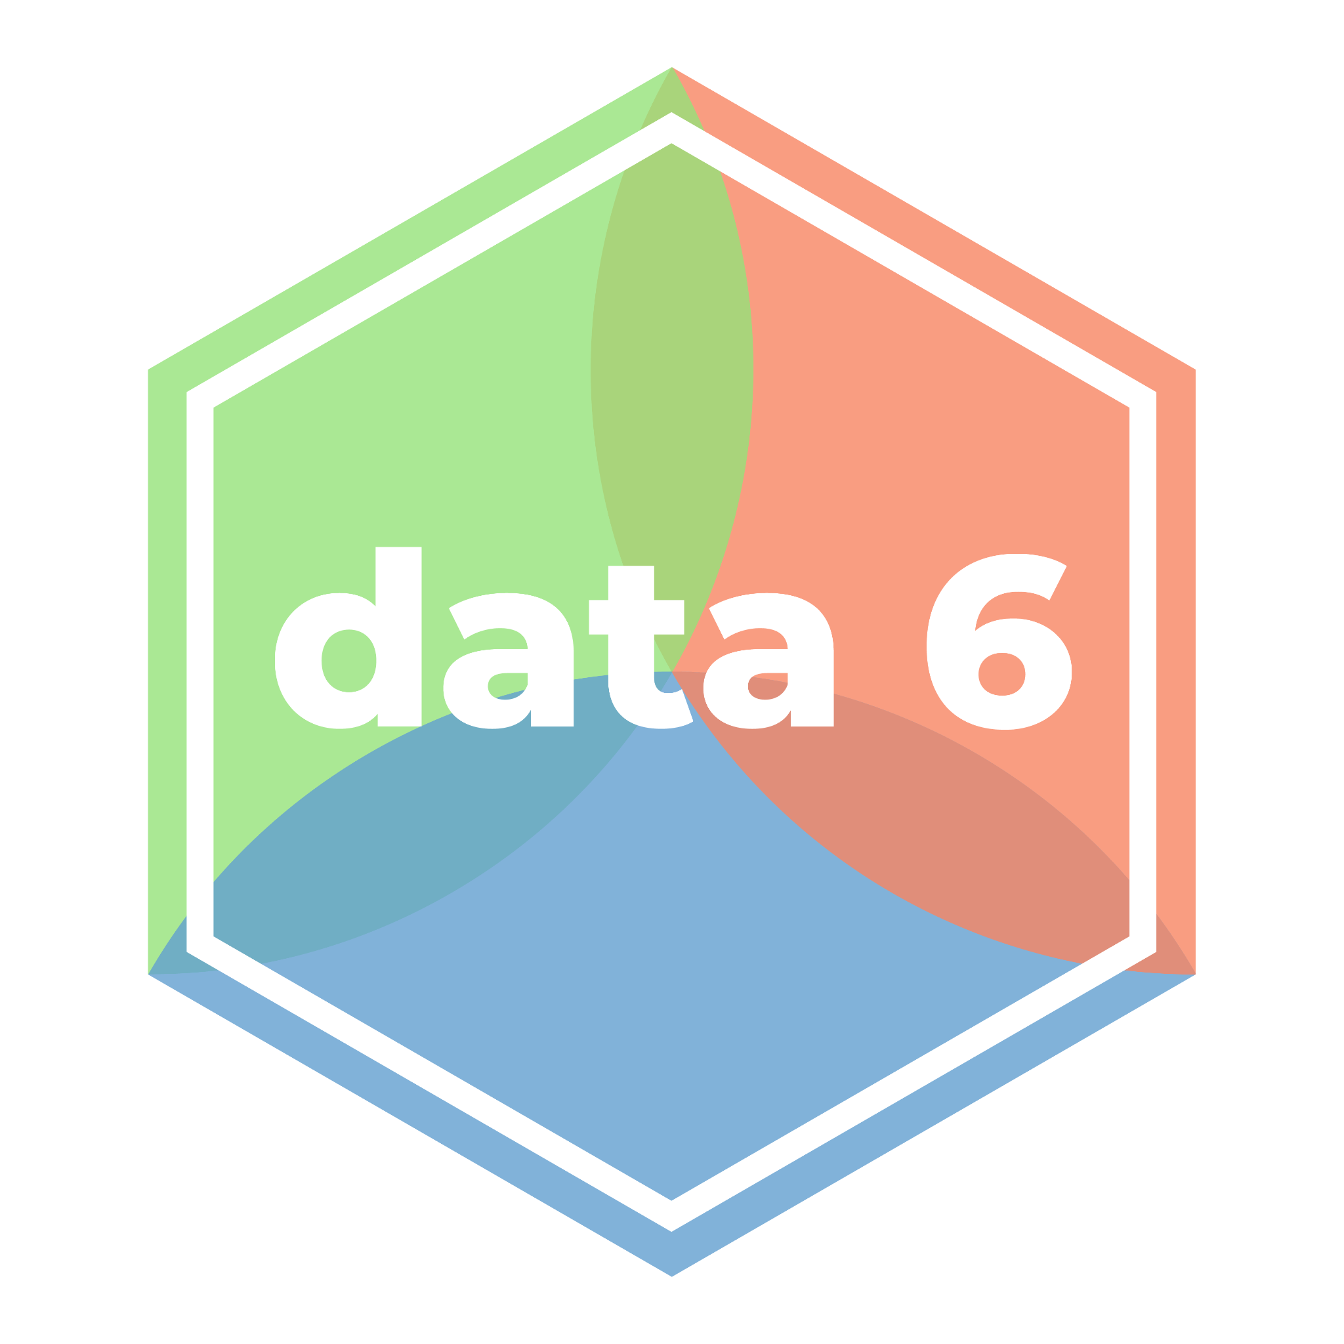
Jupyter Notebooks, Arithmetic
LECTURE 02
Getting familiar with our computing environment, and
writing our first Python programs.
Spark 010 Spring 2024
Developed by students and faculty at UC Berkeley and Tuskegee University
data6.org/su23/syllabus/#acknowledgements-

Slide 2
Today’s Roadmap
Programming in Python
What Is Python Code?
Where Do We Write Code?
Arithmetic
Expressions and Operators
Example: Incidence
Jupyter Shortcuts
Lecture 02, Spark 010 Spring 2024

Slide 3
Experiences with Coding

Slide 4
What is Python Code?
➤
1. Programming in Python
2. Arithmetic
3. Jupyter Shortcuts

Slide 5

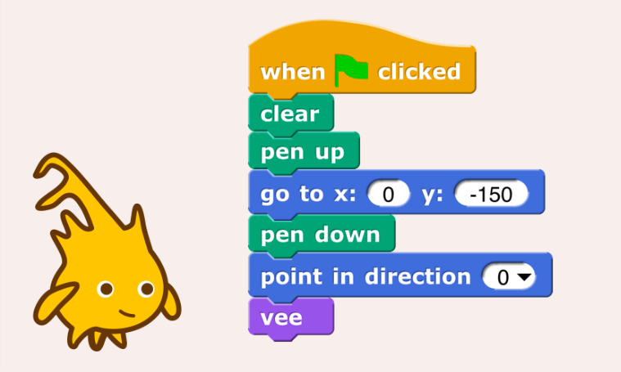

What is a computer program? What is code?
A computer program is a [set or sequence] of instructions in a programming language. [Wikipedia]
Computer programs are nothing more than recipes: we write programs that tell the computer exactly what to do, and it does exactly that – nothing more, and nothing less.
Common but hot take: computers are dumb.
Code refers to a computer program written in a particular programming language.
In this class, we use the Python language to write Python code.
def add(num1, num2):
sum = num1 + num2
return sum
result = add(2, 4)
Example Python code
Snap code (CS10)

Slide 6
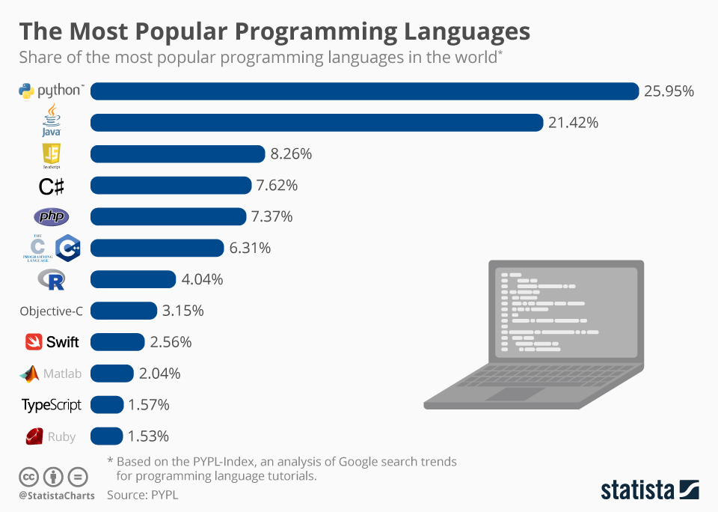
Why Python?
Popular.
Variety of uses.
Web development.
Scientific computing.
Data science and machine learning.
Not really used for developing applications.
CSE 022, Math 032, and more!
Easy to dive right in!

Slide 7
Where Do We Write Code?
➤
1. Programming in Python
2. Arithmetic
3. Jupyter Shortcuts

Slide 8
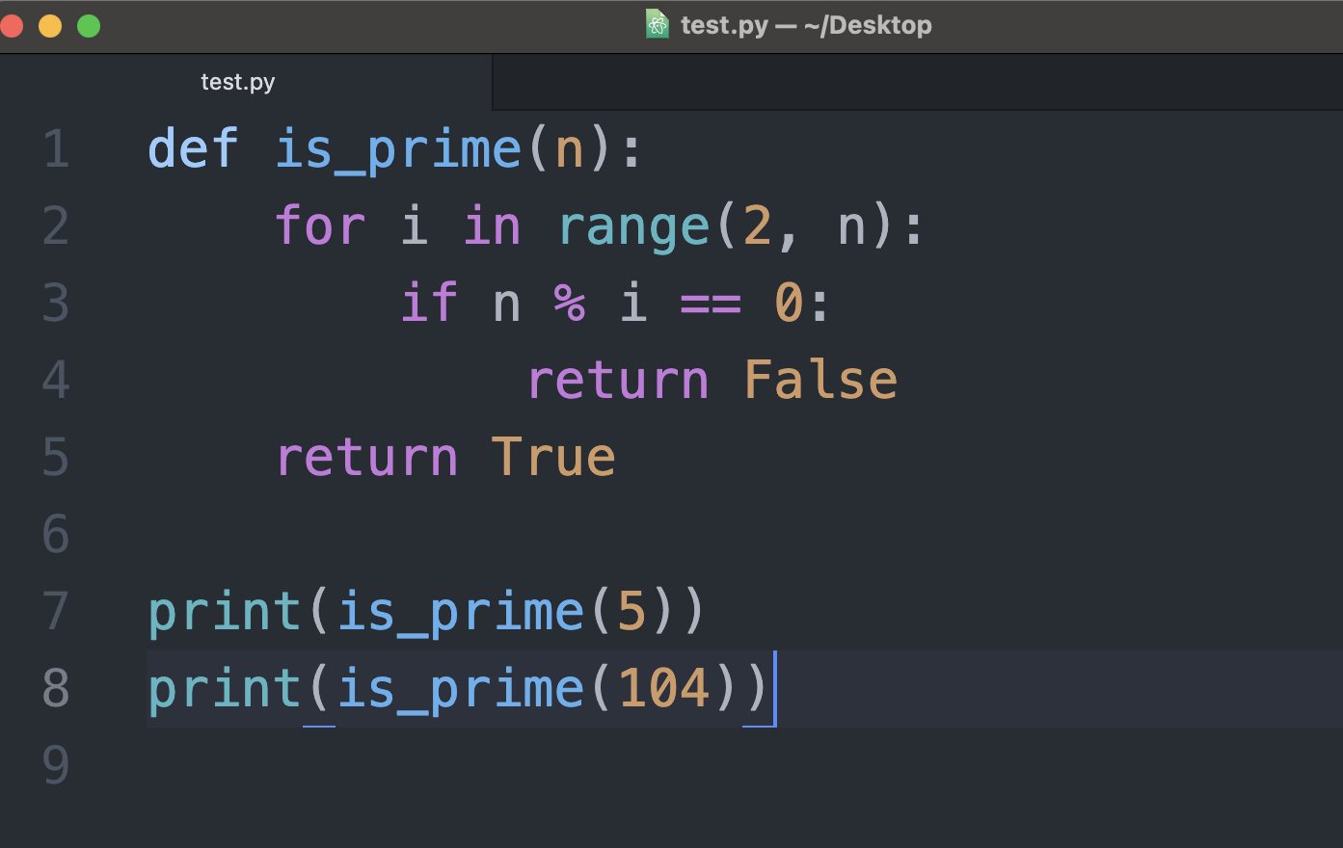
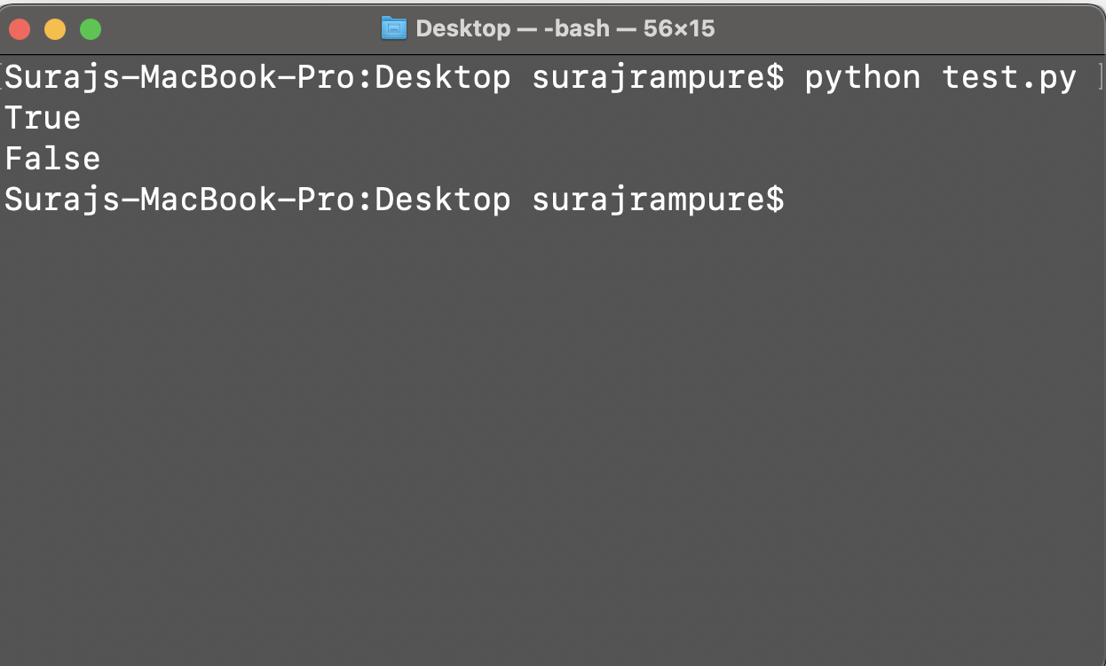

Where do we write code?
Traditionally, code is written in a text editor or IDE, and then run in a command-line interface.
While we could do everything in command-line interfaces, they aren’t the best suited for data science work, which often requires visualizations and written reports.
Atom, a popular text editor.
Command Line Interface

Slide 9
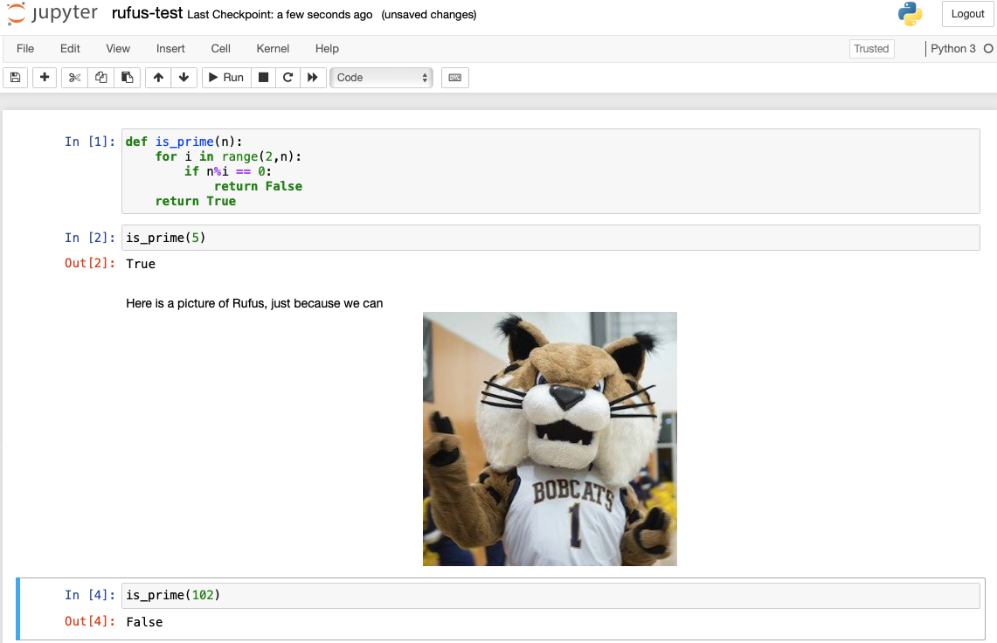
Where do we write code?
Jupyter Notebooks allow us to write and run code within a single document. They also allow us to embedded text and code. We will use these exclusively!
You will learn about more coding tools if you take more CS/DS classes.
An example Jupyter Notebook

Slide 10
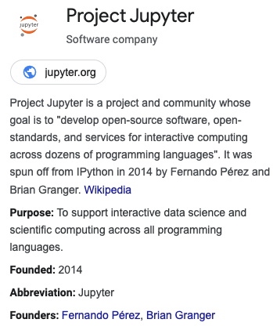
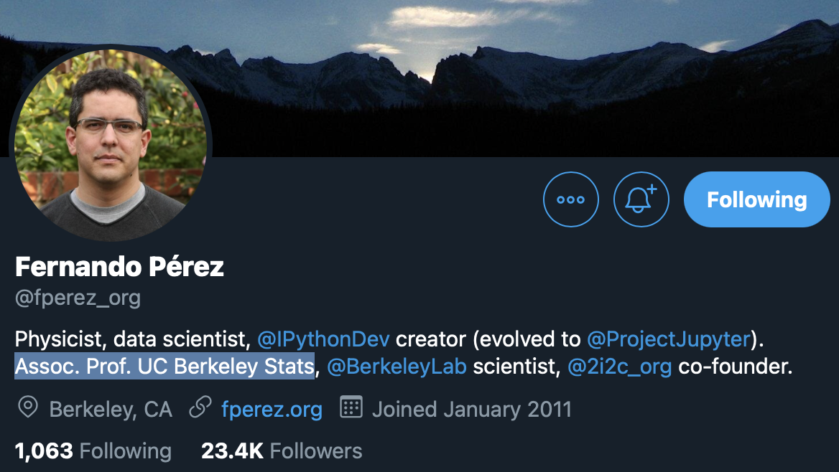
A Brief History of Jupyter
Fernando Pérez’s Faculty Page

Slide 11
DataHub
We access all code in this class by going to
datahub.berkeley.edu
DataHub is a Berkeley-hosted server that runs Jupyter notebooks. All students have their own DataHub “container”; think of this as your own virtual computer.
This is where you will work on all assignments.
You will not need to install anything locally (meaning that you could theoretically do all assignments for this class on your phone). All you need is a web browser.
Course staff can access everything in your DataHub to help debug your code.
Works like magic! Let’s go there now.

Slide 12
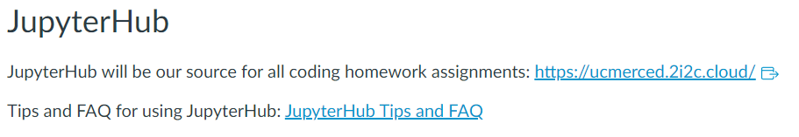
Two ways to access Jupyter Notebooks
Go to ucmerced.2i2c.cloud
Go to jupyter.org/
Go to our Catcourses home page:
Accessing Jupyter Notebook

Slide 13
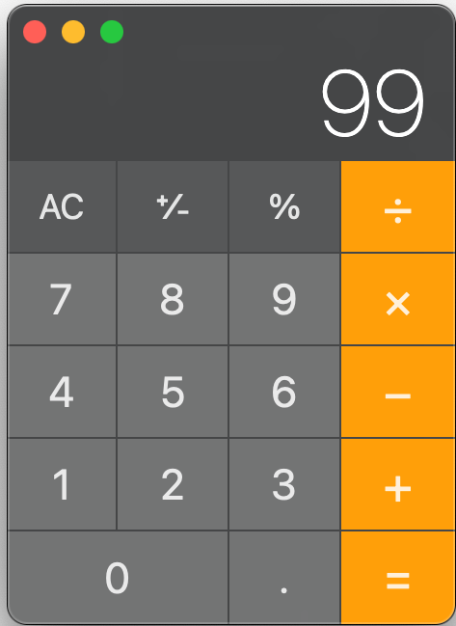
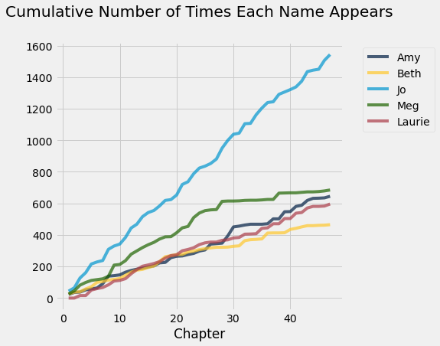

Why write code as a data scientist?
Compute
Visualize
Share

Slide 14
Expressions and Operators
1. Programming in Python
2. Arithmetic
3. Jupyter Shortcuts
➤

Slide 15
Python as a calculator
For now, think of Python as a calculator:
Calculators take expressions and compute values.
The following are all expressions.
Notes:
Expressions consist of values (like 2) and operators (like + and **).
Expressions evaluate to values.
17
-1 + 3.14
2 ** 3
(17 - 14) / 2
15 % 2
expression

Slide 16
Order of Operations
Python expressions use the same order of operations that you learned in earlier math classes (PEMDAS, aka BEMDAS).
But sometimes, it’s not clear which operator is evaluated first. When you’re not sure, or you want to fix a certain order, use parentheses.
The following expressions evaluate to different values:
60 / 2 * 3
90.0
60 / (2 * 3)
10.0

Slide 17
Common Python Operators
Operator | Symbol | Example Usage | Example Value
Addition | + | 2 + 3 | 5
Subtraction | - | 15 - 4 | 11
Multiplication | * | -2 * 9 | -18
Division | / | 15 / 2 | 7.5
Integer division Cuts off remainder | // | 15 // 2 | 7
Remainder/Modulo | % | 19 % 3 | 1 19 ÷ 3 = 6 Remainder 1
Exponentiation | ** | 3 ** 2 | 9
Our focus for now

Slide 18
Jupyter Shortcuts
1. Programming in Python
2. Arithmetic
3. Jupyter Shortcuts
➤

Slide 19
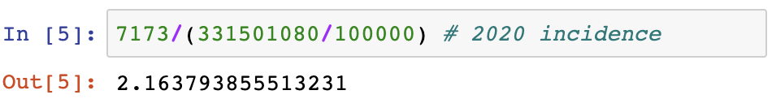
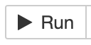
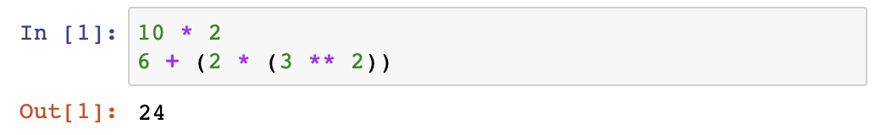
Summary So Far
Shift + Enter
Two ways to run a code cell:
Toolbar button: “Run”
Keyboard Shortcut: Shift + Enter (🌟🌟 recommended)
When you run a code cell, it runs all of the expressions you’ve written in that cell and outputs only the value of the last evaluated expression.
# evaluated, no output
# evaluated, yes output

Slide 20
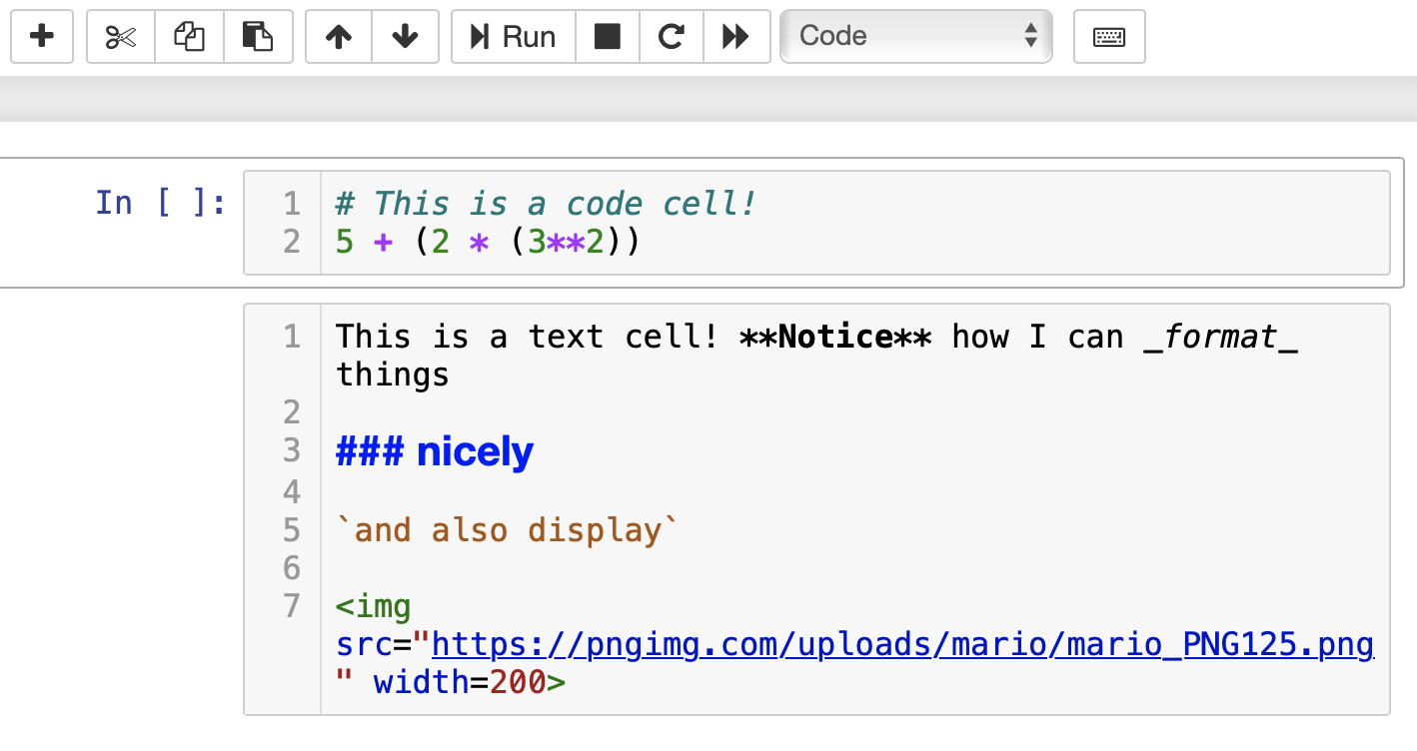
Cells
Jupyter Notebooks are made up of cells. There are two main types of cells:
Code cells. This is where you write and execute code.
When run, code cells output the value of the last evaluated expression.
Markdown cells. This is where you write text and images that aren’t Python code.
You’ll explore Markdown in lab (documentation).
Markdown cells are always “run”, except when you’re editing them.
In this dropdown menu, you can view and change the type of cell you are currently editing.

Slide 21
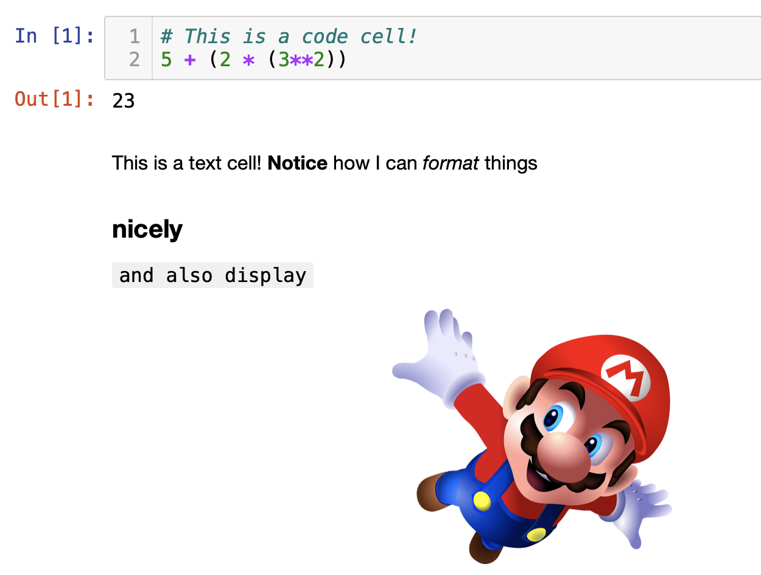
Markdown Cells
2x
Shift + Enter
2x

Slide 22
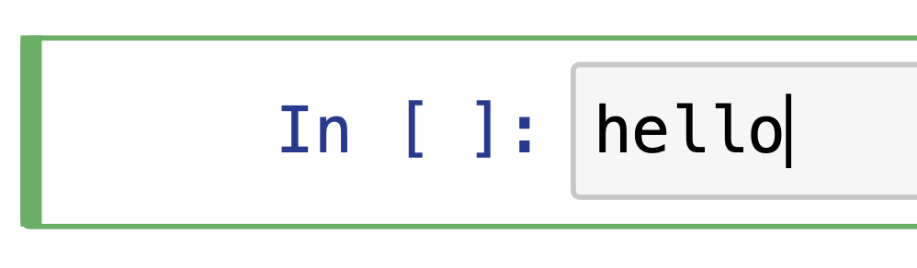
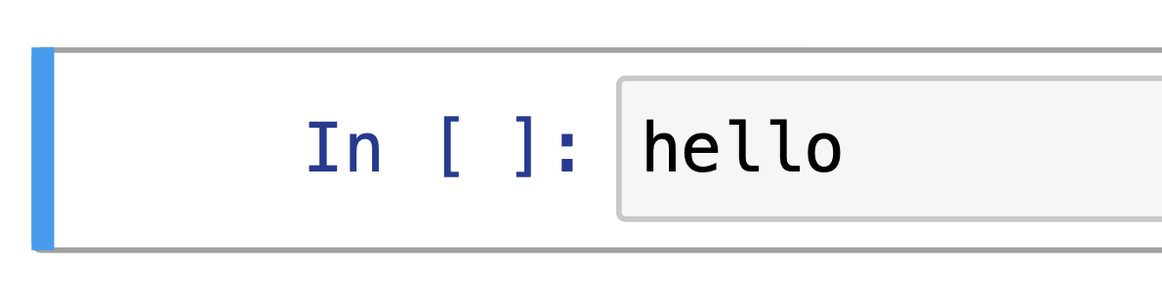
Edit mode vs. command mode
Keyboard shortcuts are specific to the mode you’re using.
Hit the ESCAPE key on your keyboard to switch from edit mode to command mode.
Edit mode: when you’re actively typing in the cell.
Command mode: when you’re not actively typing in the cell.
Undo: CTRL/CMD + Z
Undo: Z

Slide 23
Reference for Keyboard Shortcuts
Action | Mode | Keyboard shortcut
Run cell + jump to next cell | Either (puts you in edit mode) | SHIFT + ENTER
Save notebook | Either | CTRL/CMD + S
Switch to command mode | Either (puts you in command mode) | ESCAPE
Switch to edit mode | Command | ENTER
Comment out the current line | Edit | CTRL/CMD + /
Create new cell above/below | Command | A/B
Delete cell | Command | DD
Convert cell to Markdown | Command | M
Convert cell to code | Command | Y
Show all shortcuts | Command | H
Use this as a reference, don’t try to memorize these right now. Also, you can always use the toolbar!! You don’t have to use the keyboard shortcut.

Slide 24
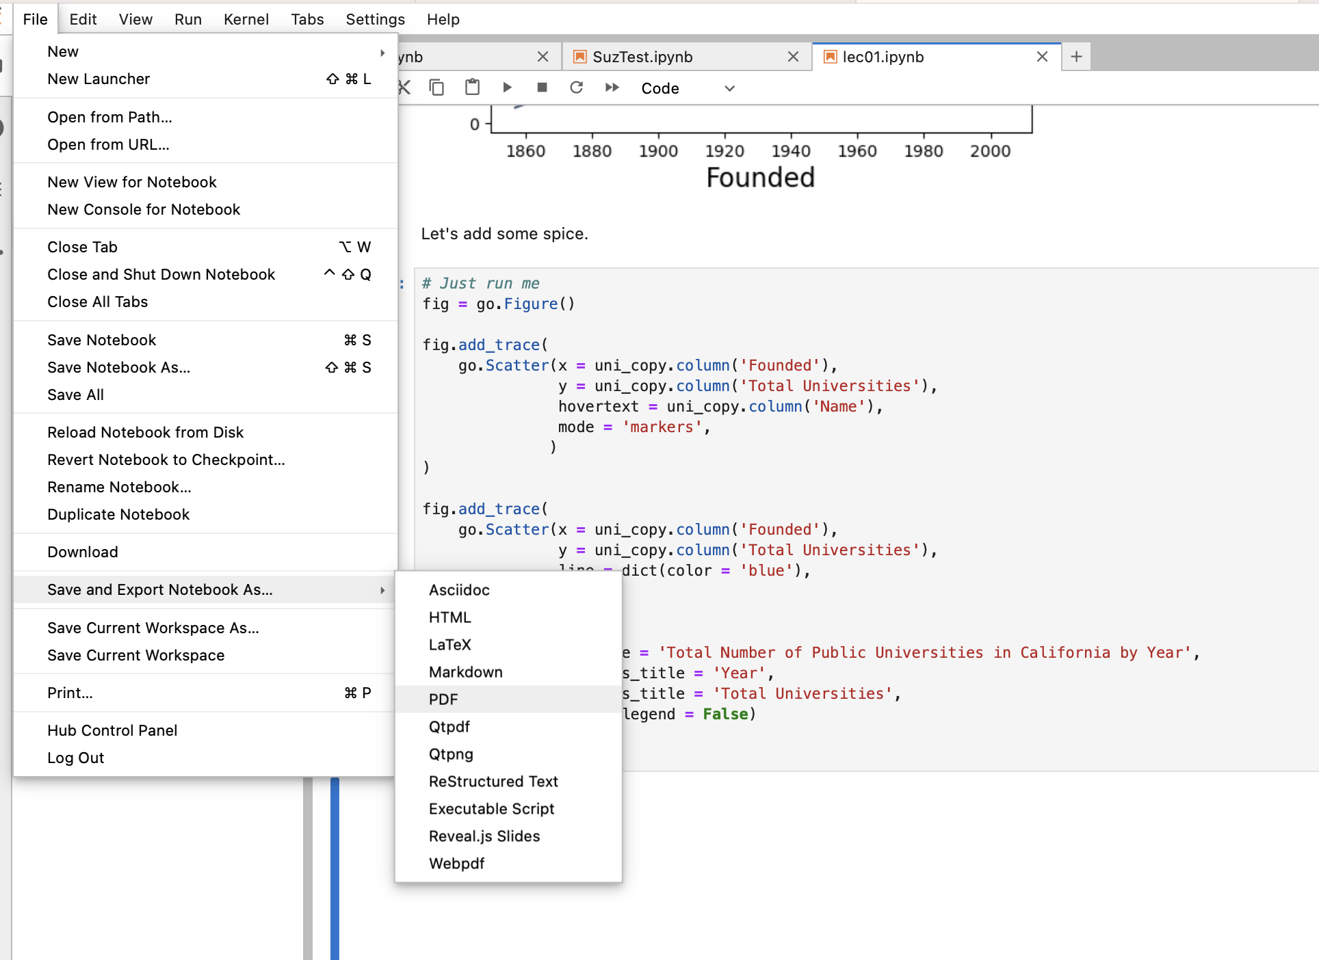
How to get Credit? (For today and all days!)
Export the Lecture 02 file (lec02.ipynb) as a PDF and upload it to Assignment 1 - Notebook Upload
Go to file->
Save and Export Notebook As …_>
PDF

Slide 25
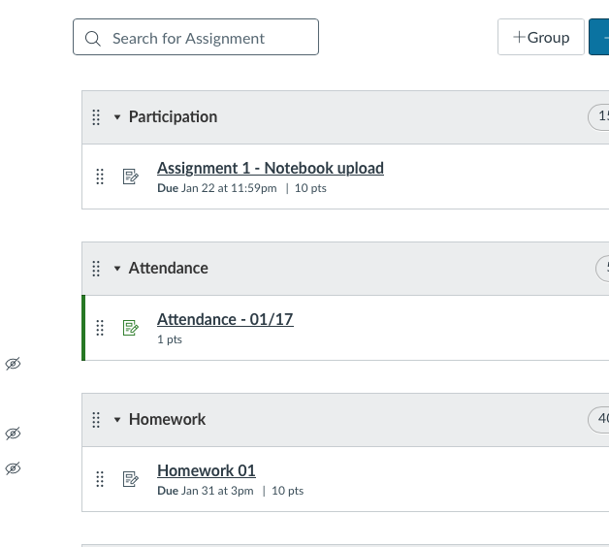
How to get Credit? (For today and all days!)
Export the Lecture 02 file (lec02.ipynb) as a PDF and upload it to Assignment 1 - Notebook Upload
Go to Catcourses->
Assignments->
Assignment 1- Notebook Upload
Upload your submission
and you’re off the hook for today!

Slide 26
In Conclusion…

Slide 27
Summary
We write code to tell our computer what to do. In this class, and in many other settings, we use the Python programming language.
We write all of our code in Jupyter Notebooks, which allow us to see the output of our code in the same document in which we wrote our code. They’re commonly used in data science.
Python can be thought of as a calculator, that takes expressions and computes their values.
We learned several different arithmetic operators, each of which can be used in an expression.
Python stores integers and decimals in different ways.

Slide 28
Recap
Next Time
What is code?
How do we run code?
Arithmetic.
Running our first programs.
Comments
More about Data Types
Errors

